Slide 1
Carbon City Planner
- To build the most enrironment-friendly city
Presented by: LLLenroc (Haoyang Li, Xiaoyi Li, Zhihui Liu)
Haoyang Li, Zhihui Liu, Xiaoyi Li

Slide 2
Outline
Introduction
Game demo
Conclusion

Slide 3
Introduction
“Although the city comprises only 2% of the total surface area of Earth, 80 % of the world’s greenhouse gases (GHG) is emitted from urban regions.” [1]
[1] http://www.c40seoulsummit.com/

Slide 4
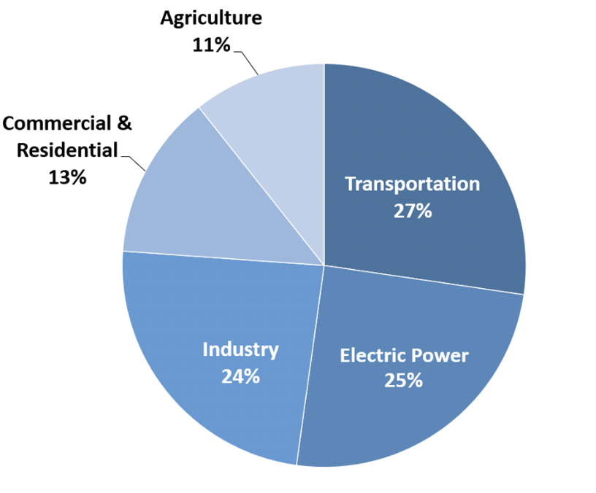
Introduction
Transportation emittes twice as much GHG as the commercial and residential areas.
⇒ The key is to minimize the total commuting distance of the city.
Fig 1. The total US Greenhouse Gas Emissions by Energy Sector in 2020 [2]
[2] https://www.epa.gov/ghgemissions/sources-greenhouse-gas-emissions

Slide 5
Introduction
Therefore, it is necessary to have an urban planning software to design an environmental-friendly city layout.

Slide 6
Data Support
Table 1 The carbon emissions for different commuting types [3]
Commuting types | Greenhouse gas emissions per km per passenger (g)
Bus | 105 g
Small car (petrol) | 154 g
Cycling or Walking | 16-50 g
⇒ Bus : Private car: Walking = 2 : 3 : 1
[3] https://ourworldindata.org/travel-carbon-footprint

Slide 7
Data Support
Table 2 The carbon emissions or absorptions for city blocks [3]
City Block types | Greenhouse gas emissions/ absorptions per block
Industry | 21%
Residence | 12%
Park | -11%
⇒ Park : Residence : Industry = -1 : -1 : 2
[4] https://climatechange.chicago.gov/ghgemissions/sources-greenhouse-gas-emissions

Slide 8
Tool design
summarize the city blocks into three types: residential block, commercial block and park block.
Each block has a base carbon emissions ( for parks, it is negative).
The player gets to place these blocks into a manhattan style road grid.
Simulate a daily routine of each person randomly and calculates its overall daily carbon emissions caused by transportations.
The total carbon emission will be the carbon emission of this layout.
Find the best layout with minimal average carbon emissions, given a fixed number of residences and that everyone is employed.

Slide 9
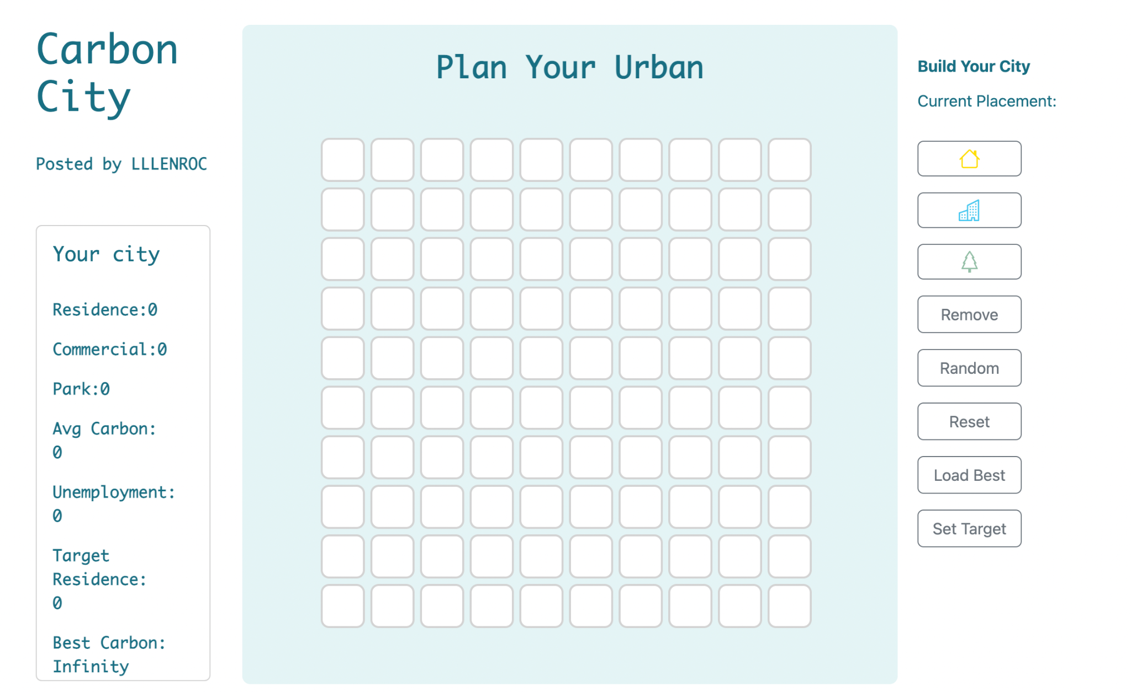

Slide 10
Conclusion
Different city layout can be self-designed or generated randomly.
The carbon emissions of different cities are visualized in the histogram and can be compared.
The most environment-friendly city layout can be loaded.

Slide 11
Thank you!

